Slide 1
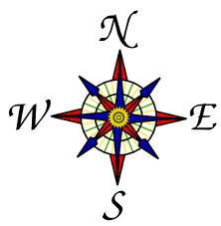
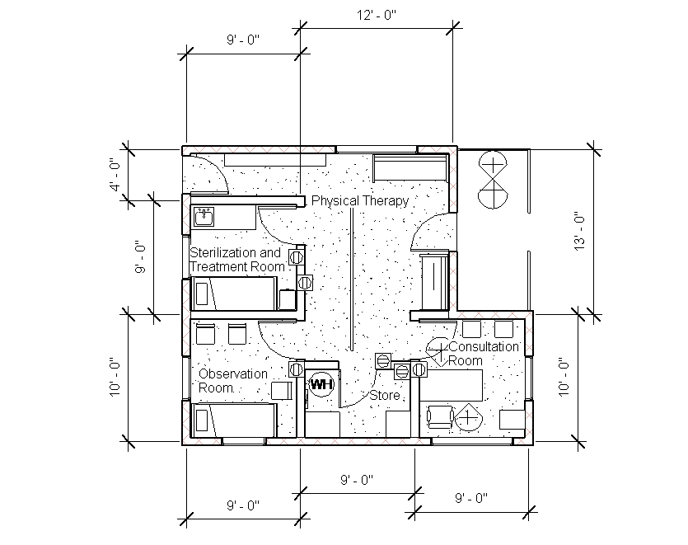
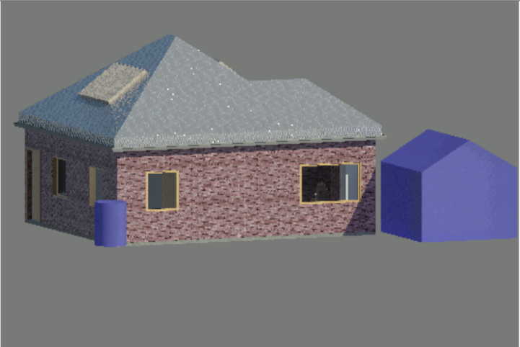
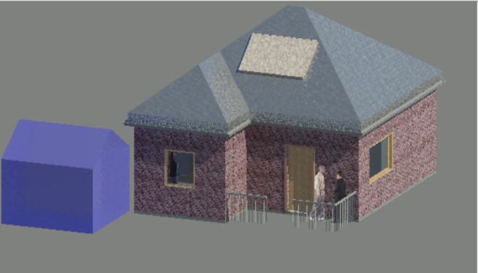
N
S
W
E
Potential Credits
LEED for Neighborhood Developed location
Sensitive land protection
Reduced parking footprint
Construction activity pollution prevention
Site assessment/development-protect or restore habitat
Open space
Rainwater management
Light pollution reduction
Fundamental commissioning and verification
Minimal Energy performance/Building-level energy metering
Fundamental refrigerant management
Optimize energy performance
Advanced energy metering
Renewable energy production
Enhanced refrigerant management
Outdoor/indoor water use reduction
Building-level water metering
Storage and collection of recyclables
Construction and demolition waste management planning
Building life-cycle impact reduction
Minimum indoor air quality performance
Environmental tobacco smoke control
Low-emitting materials
Enhanced indoor air quality strategies
Daylight/ interior lighting
Sierra Leone Treatment Facility
Key Notes
North/South orientation
Concrete flooring
Mud-brick construction
Insulated roofing
Ceiling fans
Physical therapy features
Water collection system
Solar and electrical panel
Ebola check-station tent
By: Anthony Davala, Brian Brennan, Greyson McDonald

